Slide 1




Excel
Training
for Beginners
SAID FAWZY
Manager of Information Center
Tendering Department
Arab Contractors

Slide 2


Excel
Training
for Beginners
SAID FAWZY
2
WORKING WITH WORKBOOKS AND WORKSHEETS

Slide 3






90%
90%
1-WORKING WITH EXCEL TEMPLATES
2-WORKBOOKS AND WORKSHEETS
3-SAVING AND ORGANIZING FILES
4-ENTERING AND EDITING DATA
5-NAVIGATING AND SELECTING DATA

Slide 4
90%
90%
EXAM 2: Workbooks and Worksheets

Slide 5
Excel
Training
for Beginners
SAID FAWZY
WORKING WITH EXCEL TEMPLATES
1

Slide 6
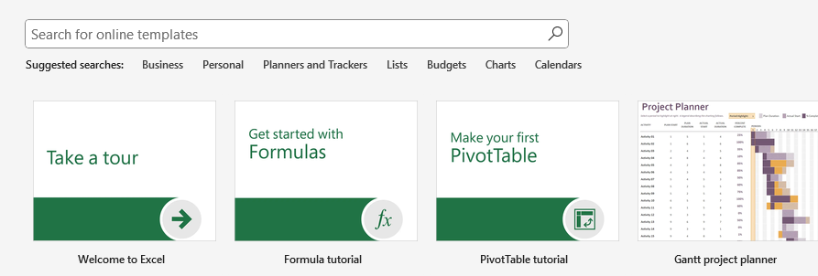
Working with Excel Templates
Create workbook from a template

Slide 7
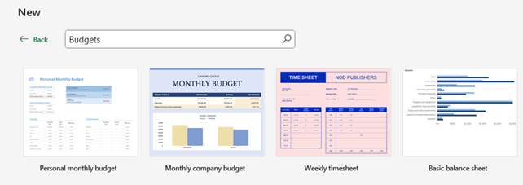
Working with Excel Templates
Create workbook from a template

Slide 8
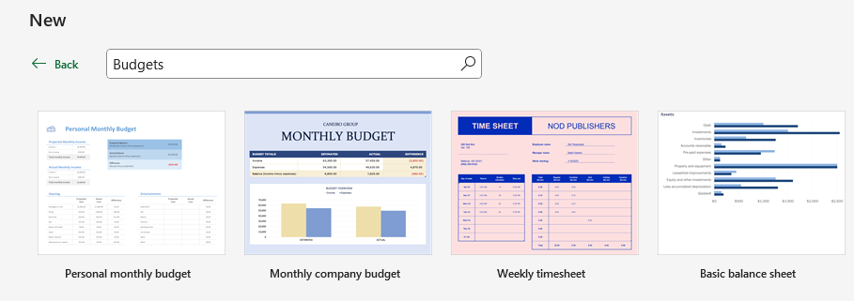
Working with Excel Templates
Create workbook from a template

Slide 9
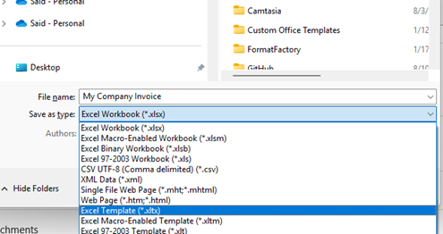
Working with Excel Templates
Create workbook from a template

Slide 10
Working with Excel Templates
Create workbook from a template

Slide 11
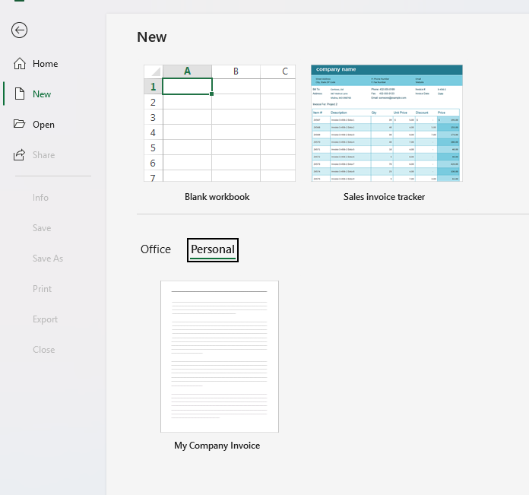
Working with Excel Templates
Reuse the saved Template

Slide 12
Excel
Training
for Beginners
SAID FAWZY
WORKBOOKS AND WORKSHEETS
2

Slide 13
Working with Workbooks and Worksheets
Worksheet
Cells
Cell Reference

Slide 14

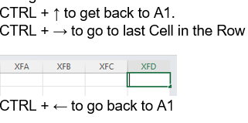
Working with Workbooks and Worksheets
Navigations

Slide 15
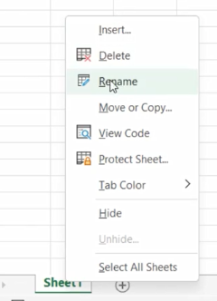
Working with Workbooks and Worksheets
Rename Worksheet

Slide 16
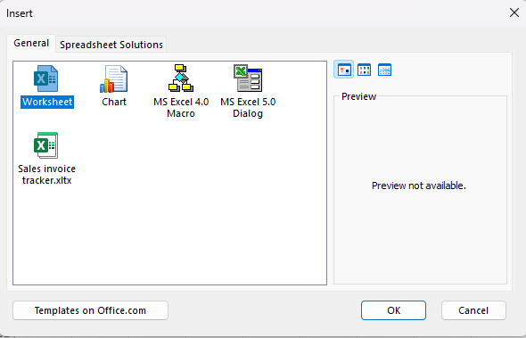

Working with Workbooks and Worksheets
Insert Worksheets

Slide 17
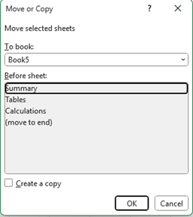
Working with Workbooks and Worksheets
Move or Copy Worksheet

Slide 18

Working with Workbooks and Worksheets
Change Tab Color

Slide 19
Excel
Training
for Beginners
SAID FAWZY
SAVING AND ORGANIZING FILES
3

Slide 20


SAVING AND ORGANIZING FILES
Save File

Slide 21
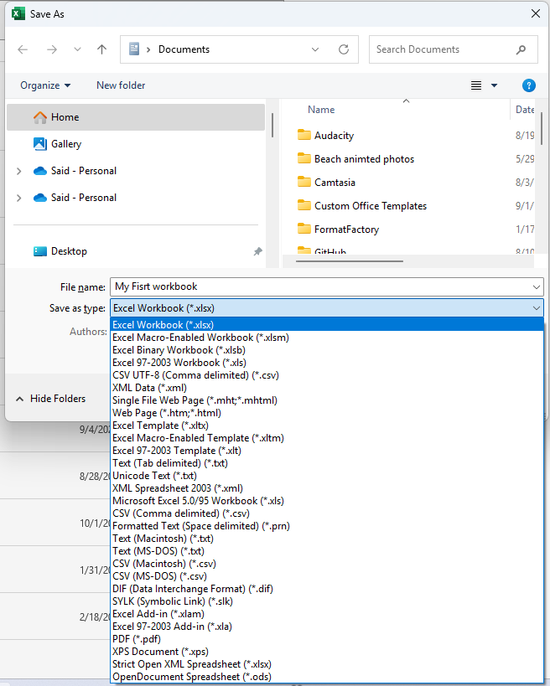
SAVING AND ORGANIZING FILES
Save File

Slide 22
Excel
Training
for Beginners
SAID FAWZY
ENTERING AND EDITING DATA
4

Slide 23
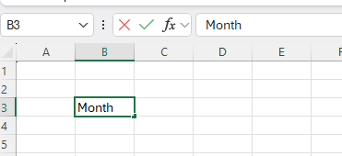

ENTERING AND EDITING DATA
Enter Data

Slide 24
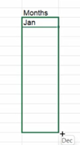
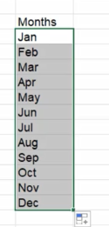

ENTERING AND EDITING DATA
Autofill Handle

Slide 25
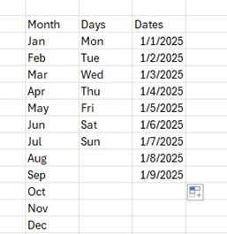
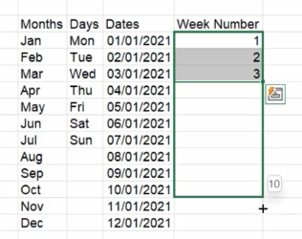
ENTERING AND EDITING DATA
Autofill Handle

Slide 26

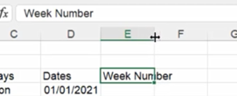
ENTERING AND EDITING DATA
Autofit Columns

Slide 27

ENTERING AND EDITING DATA
Edit Cells

Slide 28
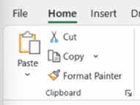
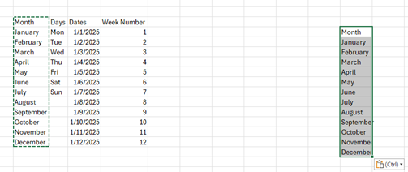
ENTERING AND EDITING DATA
Copy and Paste

Slide 29
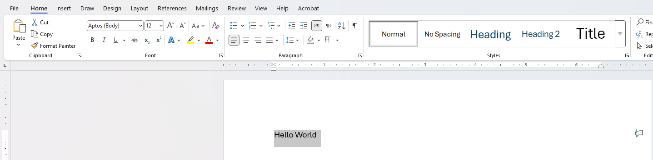
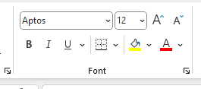
ENTERING AND EDITING DATA
Copy and Paste

Slide 30
Excel
Training
for Beginners
SAID FAWZY
NAVIGATING AND SELECTING DATA
5

Slide 31
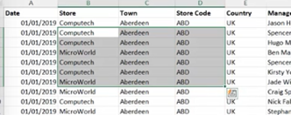
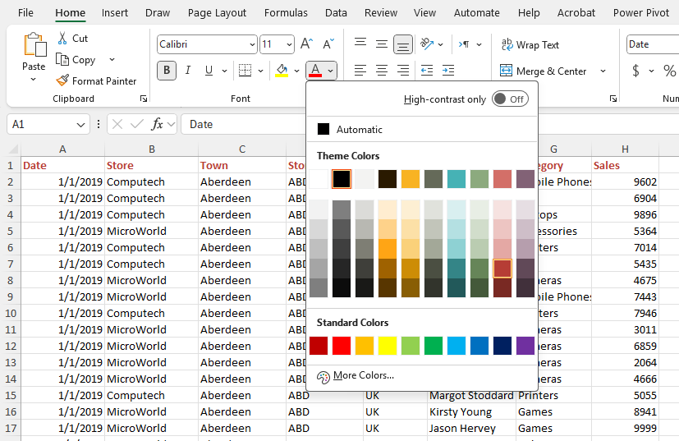
NAVIGATING AND SELECTING DATA
Selection

Slide 32
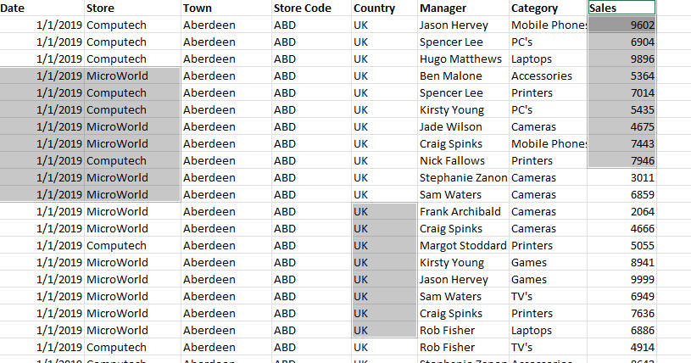
NAVIGATING AND SELECTING DATA
Select non-adjacent cells
CTRL

Slide 33
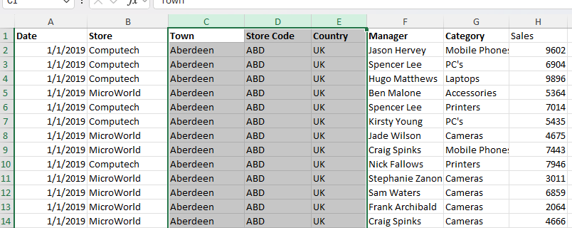
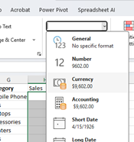
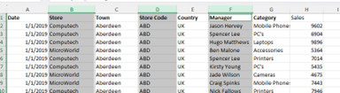
NAVIGATING AND SELECTING DATA
Select whole column
CTRL

Slide 34
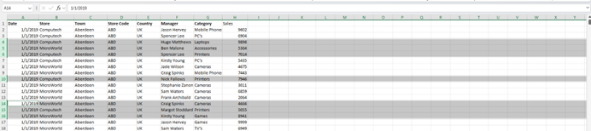
NAVIGATING AND SELECTING DATA
Select whole Row

Slide 35
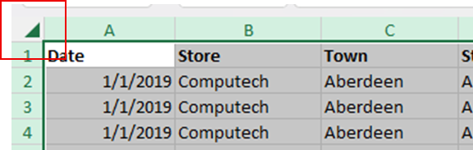
NAVIGATING AND SELECTING DATA
Select All

Slide 36
Excel
Training
for Beginners
SAID FAWZY
Exam 2
Workbooks and Worksheets

Slide 37
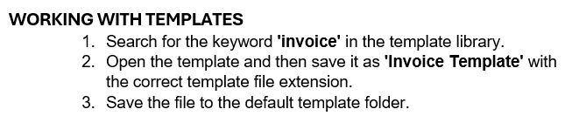
Exam 2: Workbooks and Worksheets

Slide 38
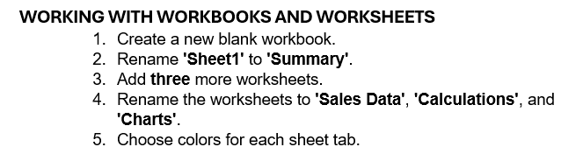

Exam 2: Workbooks and Worksheets

Slide 39
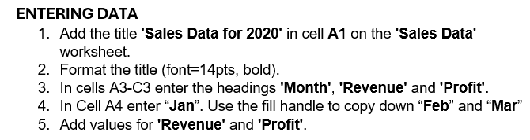
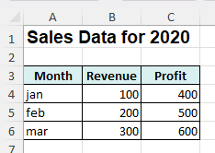
Exam 2: Workbooks and Worksheets

Slide 40

Exam 2: Workbooks and Worksheets

Slide 41



